Slide 1

6th Grade Accelerated Math
Unit 3, Lesson 3 Plotting, Ordering, and Comparing Rational Numbers – Part 1 Volume 1, pg. 87

Slide 2


Benchmark
MA.6.NSO.1.1
Extend previous understanding of numbers to define rational numbers. Plot, order, and compare rational numbers.
volume 1, pg. 87

Slide 3
Integrated Mathematical Thinking and Reasoning Standards
MA.K12.MTR.3.1 Complete tasks with mathematical fluency.
MA.K12.MTR.4.1 Engage in discussions that reflect on the mathematical thinking of self and others.
MA.K12.MTR.6.1 Assess the reasonableness of solutions.
volume 1, pg. 87

Slide 4

Learning Targets
I can plot and compare rational numbers represented as a decimal or percent.
I can plot, compare, and order fractional representations of rational numbers.
volume 1, pg. 87

Slide 5

Warm-Up
volume 1, pg. 87

Slide 6
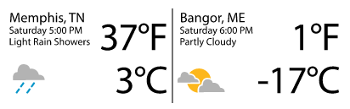
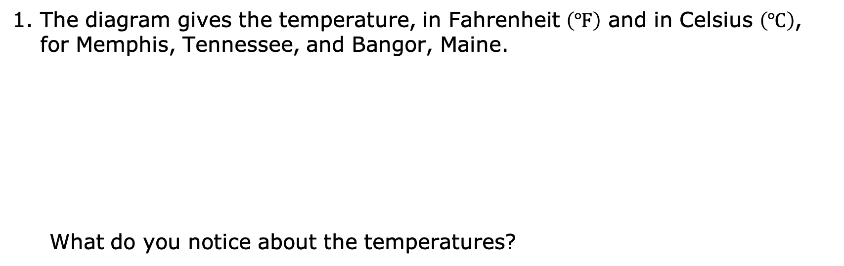
3.3.1 Warm-Up: Notice and Wonder
The diagram gives the temperature, in Fahrenheit $\left(℉\right)$ and in Celsius $\left(℃\right)$, for Memphis, Tennessee, and Bangor, Maine.
What do you notice about the temperatures?
volume 1, pg. 87

Slide 7

Guided Instruction
volume 1, pg. 88

Slide 8
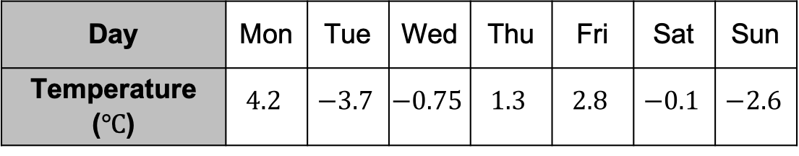
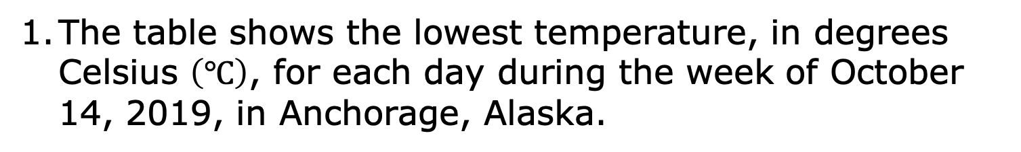
3.3.2 Guided Instruction: Comparing and Ordering Decimals
The table shows the lowest temperature, in degrees Celsius $\left(℃\right)$, for each day during the week of October 14, 2019, in Anchorage, Alaska.
Day | Mon | Tue | Wed | Thu | Fri | Sat | Sun
Temperature ($℃$) | $$4.2$$ | $$−3.7$$ | $$−0.75$$ | $$1.3$$ | $$2.8$$ | $$−0.1$$ | $$−2.6$$
Plot the temperatures on the number line.
Which temperature did you plot farthest to the left?
volume 1, pg. 88

Slide 9
What day of the week is represented by the value that was plotted farthest to the left?
Why does the location of the temperature that is plotted farthest to the left help determine which day had the lowermost temperature?
volume 1, pg. 88

Slide 10
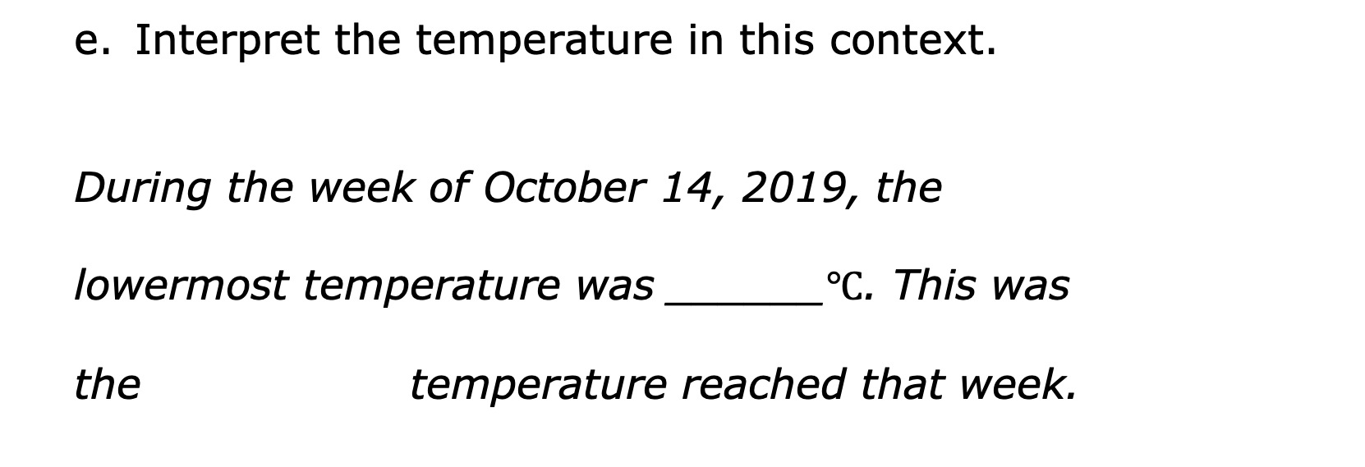
Interpret the temperature in this context.
During the week of October 14, 2019, the
lowermost temperature was ______$℃$. This was
the temperature reached that week.
warmest
coldest
volume 1, pg. 88

Slide 11
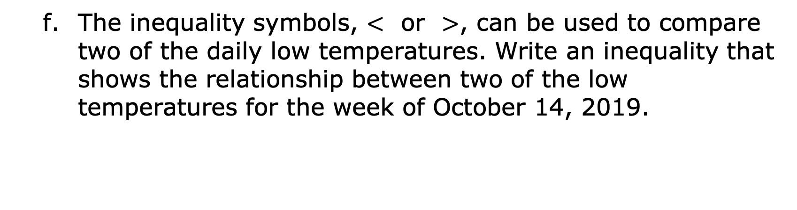
The inequality symbols, $<$ or $>$, can be used to compare two of the daily low temperatures. Write an inequality that shows the relationship between two of the low temperatures for the week of October 14, 2019.
volume 1, pg. 88

Slide 12
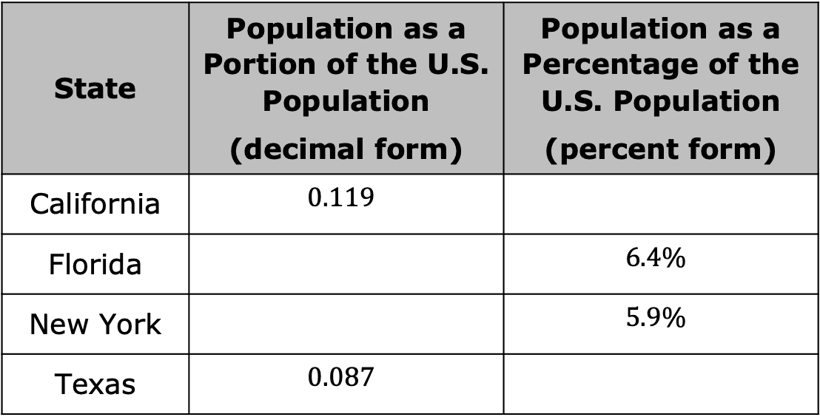
Jayden, a data analyst, is comparing the populations of four different states to the population of the United States. His data is shown in the table.
State | Population as a Portion of the U.S. Population (decimal form) | Population as a Percentage of the U.S. Population (percent form)
California | $$0.119$$
Florida |  | $$6.4\%$$
New York |  | $$5.9\%$$
Texas | $$0.087$$
volume 1, pg. 89

Slide 13
Choose two states to compare. Write or describe your comparison.
volume 1, pg. 89

Slide 14
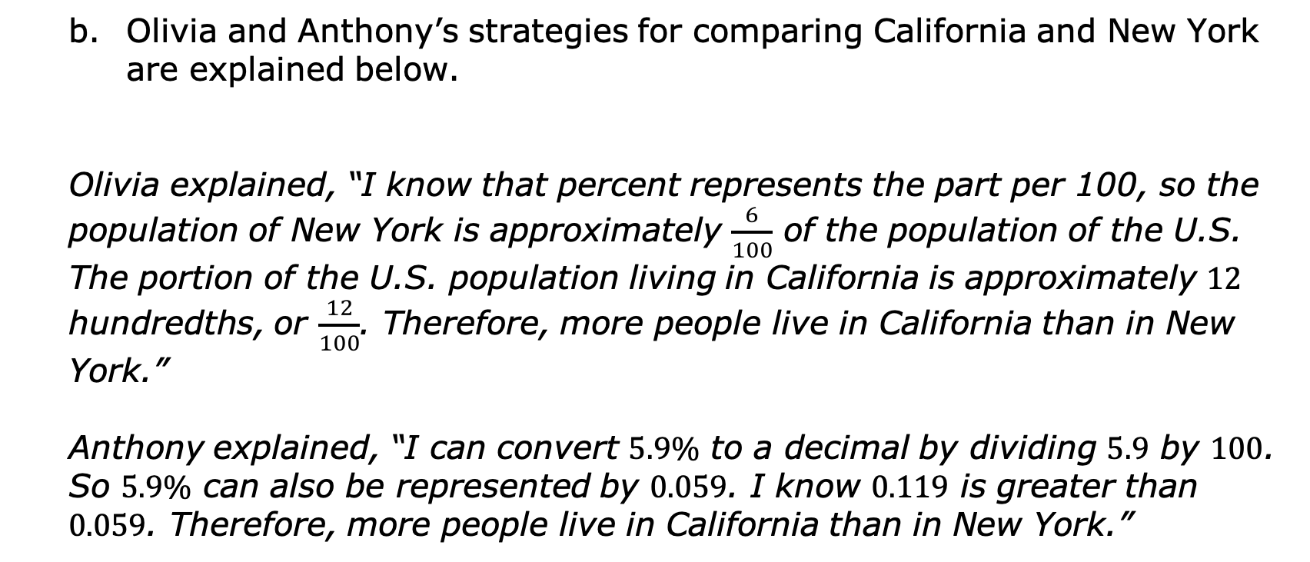
Olivia and Anthony’s strategies for comparing California and New York are explained below.
Olivia explained, “I know that percent represents the part per 100, so the population of New York is approximately $\frac{6}{100}$ of the population of the U.S. The portion of the U.S. population living in California is approximately $12$ hundredths, or $\frac{12}{100}$. Therefore, more people live in California than in New York.”
Anthony explained, “I can convert $5.9\%$ to a decimal by dividing $5.9$ by $100$. So $5.9\%$ can also be represented by $0.059$. I know $0.119$ is greater than $0.059$. Therefore, more people live in California than in New York.”
volume 1, pg. 89

Slide 15
Olivia and Anthony both used different methods to come to the same conclusion. Discuss their methods with a partner.
Olivia’s Method | Anthony’s Method
volume 1, pg. 89

Slide 16
Complete each inequality statement below to compare the given values.
In which of the four states does the highest portion of the U.S. population live?
In which of the four states does the smallest portion of the U.S. population live?
$0.119$ ___ $6.4\%$ | $6.4\%$ ___ $0.087$ | $0.087$ ___ $5.9\%$
volume 1, pg. 90

Slide 17

Exploration
volume 1, pg. 90

Slide 18


3.3.3 Exploration: Plotting and Comparing Fractions
Plot and label the rational numbers on the number line below.
$\frac{−3}{2}$ $\frac{5}{8}$ $\frac{5}{4}$ $\frac{1}{4}$ $\frac{−3}{4}$
volume 1, pg. 90

Slide 19
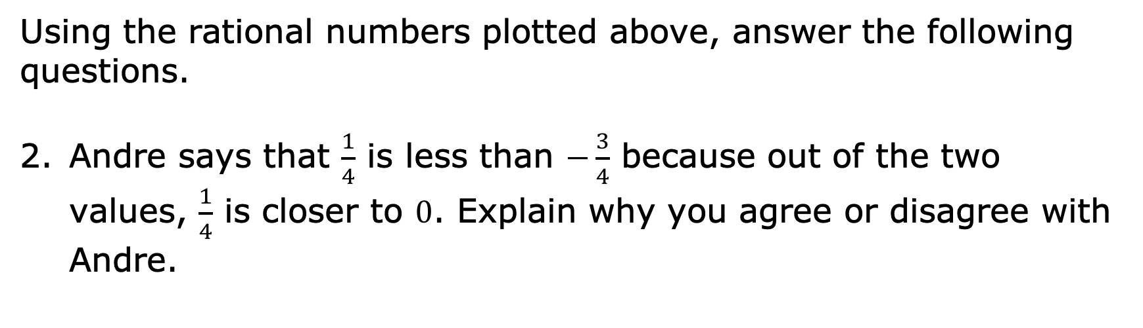
Using the rational numbers plotted above, answer the following questions.
Andre says that $\frac{1}{4}$ is less than $−\frac{3}{4}$ because out of the two values, $\frac{1}{4}$ is closer to $0$. Explain why you agree or disagree with Andre.
volume 1, pg. 90

Slide 20

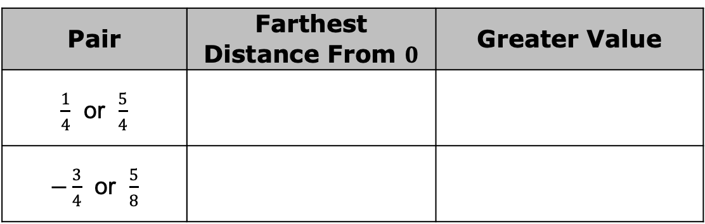
Complete the table for each pair of numbers.
Is the value that is farther from $0$ always the greater value? Explain your reasoning.
Pair | Farthest Distance From $0$ | Greater Value
$\frac{1}{4}$ or $\frac{5}{4}$
$−\frac{3}{4}$ or $\frac{5}{8}$
volume 1, pg. 91

Slide 21

Your Turn
volume 1, pg. 91

Slide 22
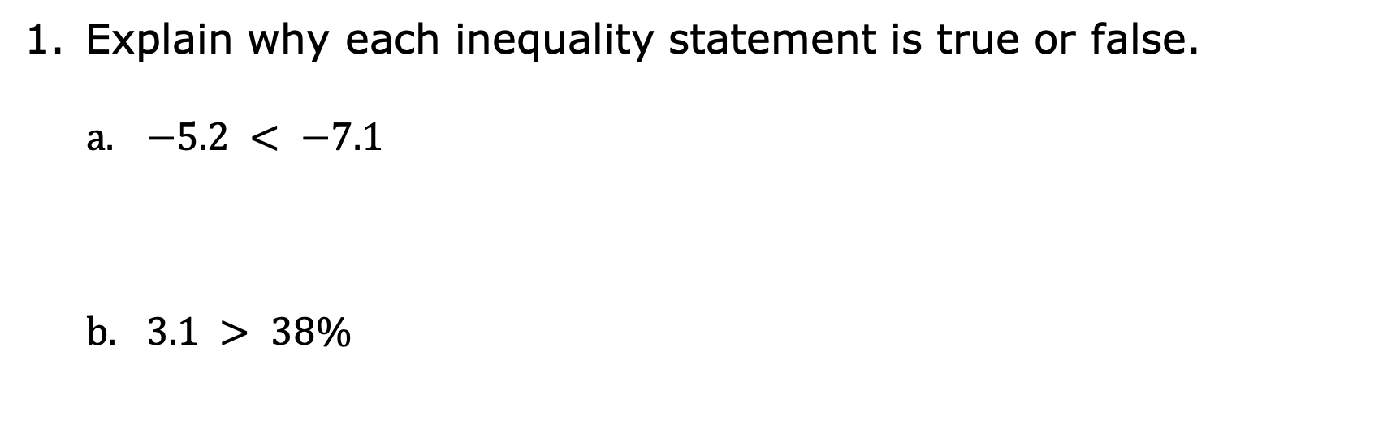
3.3.4 Your Turn!
Explain why each inequality statement is true or false.
$−5.2 < −7.1$
$3.1 > 38\%$
volume 1, pg. 91

Slide 23
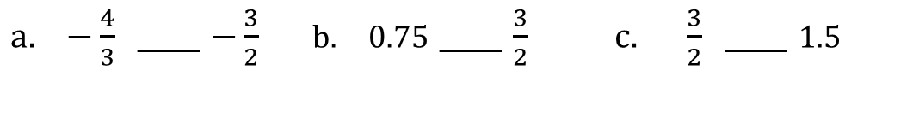
Use the symbols <, > or = to compare each pair of values.
$−\frac{4}{3}$ ___ $−\frac{3}{2}$ | $0.75$ ___ $\frac{3}{2}$ | $\frac{3}{2}$ ___ $1.5$
volume 1, pg. 91

Slide 24
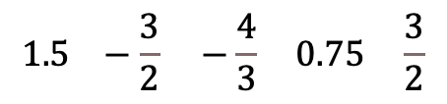
Plot the following values on the number line. Label each point with its numeric value.
Complete the inequality statement to show the relationship between the values.
$$1.5 −\frac{3}{2} −\frac{4}{3} 0.75 \frac{3}{2}$$
_______ $>$ _______ $>$ _______ $>$ _______
volume 1, pg. 92

Slide 25

Select all the values that are greater than $−5$.
$1.324$
$−6.2$
$−12.67$
$0.231$
$−1.4$
$−4.789$
volume 1, pg. 92

Slide 26
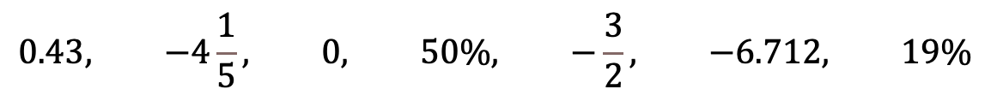
Order these values from least to greatest.
$$0.43, −4\frac{1}{5}, 0, 50\%, −\frac{3}{2}, −6.712, 19\%$$
volume 1, pg. 92

Slide 27

Wrap-Up
volume 1, pg. 92

Slide 28






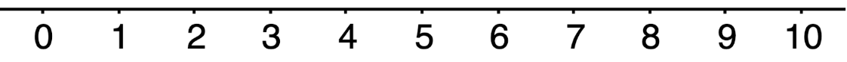
3.3.5 Wrap-Up: Reflection
Circle the emoji that best represents your understanding of the lesson today.
volume 1, pg. 92

Slide 29
Write an explanation of why you chose that emoji.
volume 1, pg. 92

